Slide 1

PG-DAC March 2022 C-DAC Know-IT Pune

Slide 2
Online movie ticket booking system
Guided By: Bakul Joshi
Project Member:
Abdulvahab Maner 220343020003
Sangram Desai 220343020026
Aditya Hande 220343020033
Vyankatesh Nakate 220343020114

Slide 3
Problem Arises
Standing in hours in long queues to get tickets booked
Time-consuming

Slide 4
Solution
View the list of movies present
View the list of theatres based on the show
Book the ticket for the specified show

Slide 5
Description
It'sShowTime has been developed to overcome the problems prevailing in the practicing manual system. The main objective of this web based application is to provide a platform for theater owners to upload information about theaters, screens, seat capacity etc. It allows owners even to allot time slots and screens for new movie releases. Customers can easily search for movies, check the theater seat availability, and book multiple tickets by using online payment and cancel the tickets if required.

Slide 6
Technologies Used
Backend:-
Java 17,SpringBoot,MySql
Frontend:-
HTML,CSS,ReactJs,Bootstrap,MaterialUI
Frontend and Backend connection with the help of Axios through REST API and fetch functionality.

Slide 7
Database Design
Created database according to ER diagram
Inserted data with the help of SQL queries
Problem:-
Every time required SQL queries to fill the data into the database
Solution:-
So we used the Hibernate mapping to insert data
directly into the database

Slide 8
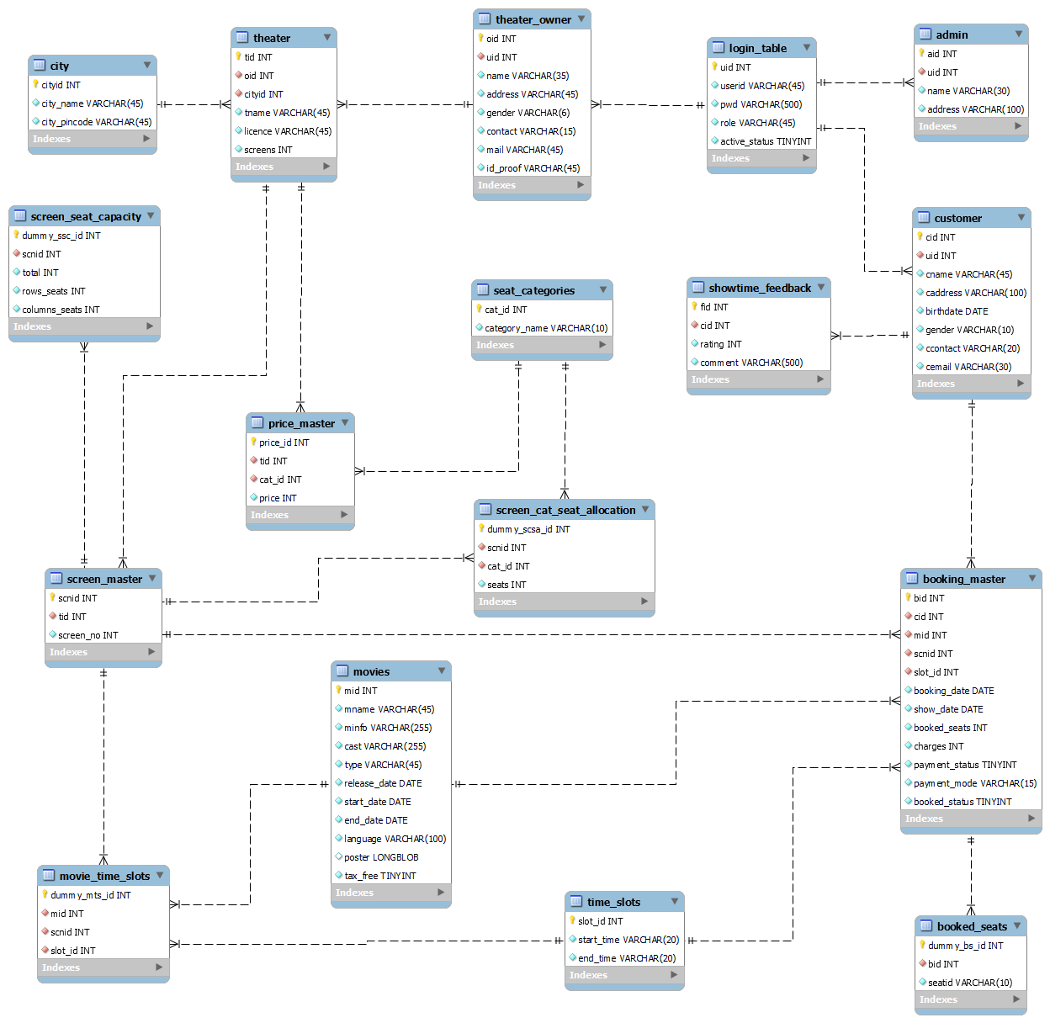
ER Diagram:-

Slide 9
Backend
Entity: Variable defining and dataset method and override ( override the string method and give output in string format).
Repository (Data access object): data access through a query.

Slide 10
Backend
Service: services we can use for CRUD operation, service layer used repository to perform the CURD operation. Also called business logic.
Controller: controller accept request from the user goto the service layer and work on the request which is sent by the user.

Slide 11
Frontend
Header:- Created Navbar using ReactJs which is common for all pages
Footer:-Provide information about Theaters contact info and near by Customer

Slide 12
Frontend
Index.html :- Basic static web page
Its ShowTime System consists of three modules described below.
Admin Module
Customer Module
Theatre owner Module
Admin functionality pages:-
Admin Login Form
Admin Verification Page
Verified Theater Owner Page
Admin Add Movie Page

Slide 13
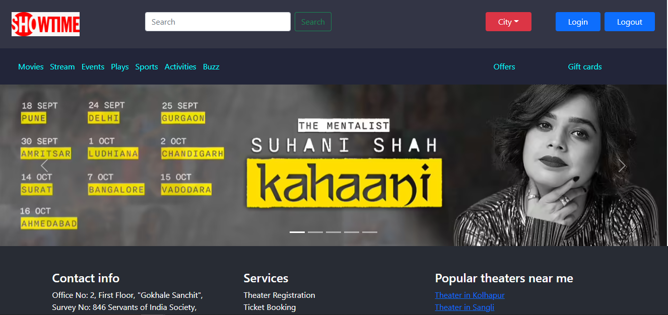
Home page

Slide 14
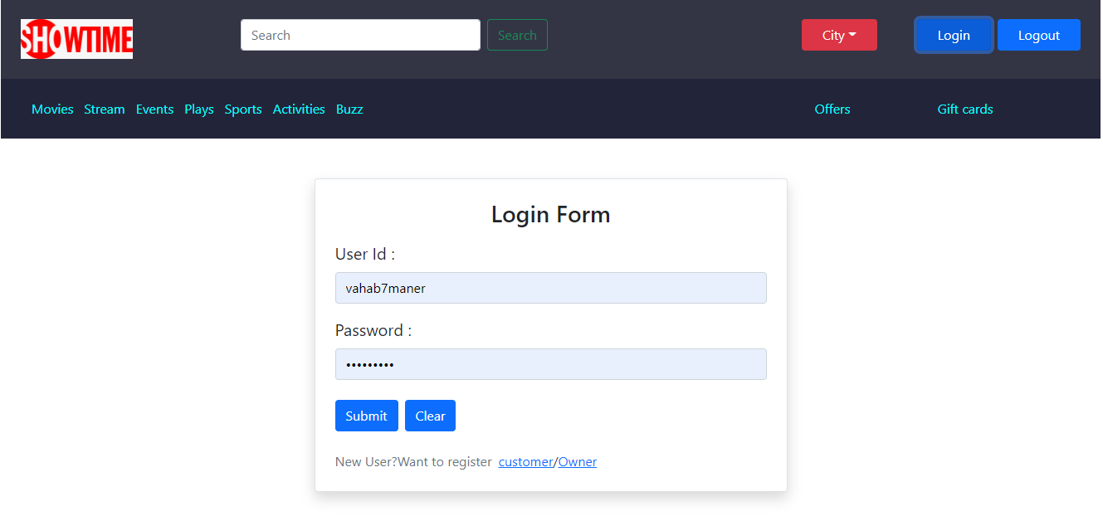
Admin Login

Slide 15
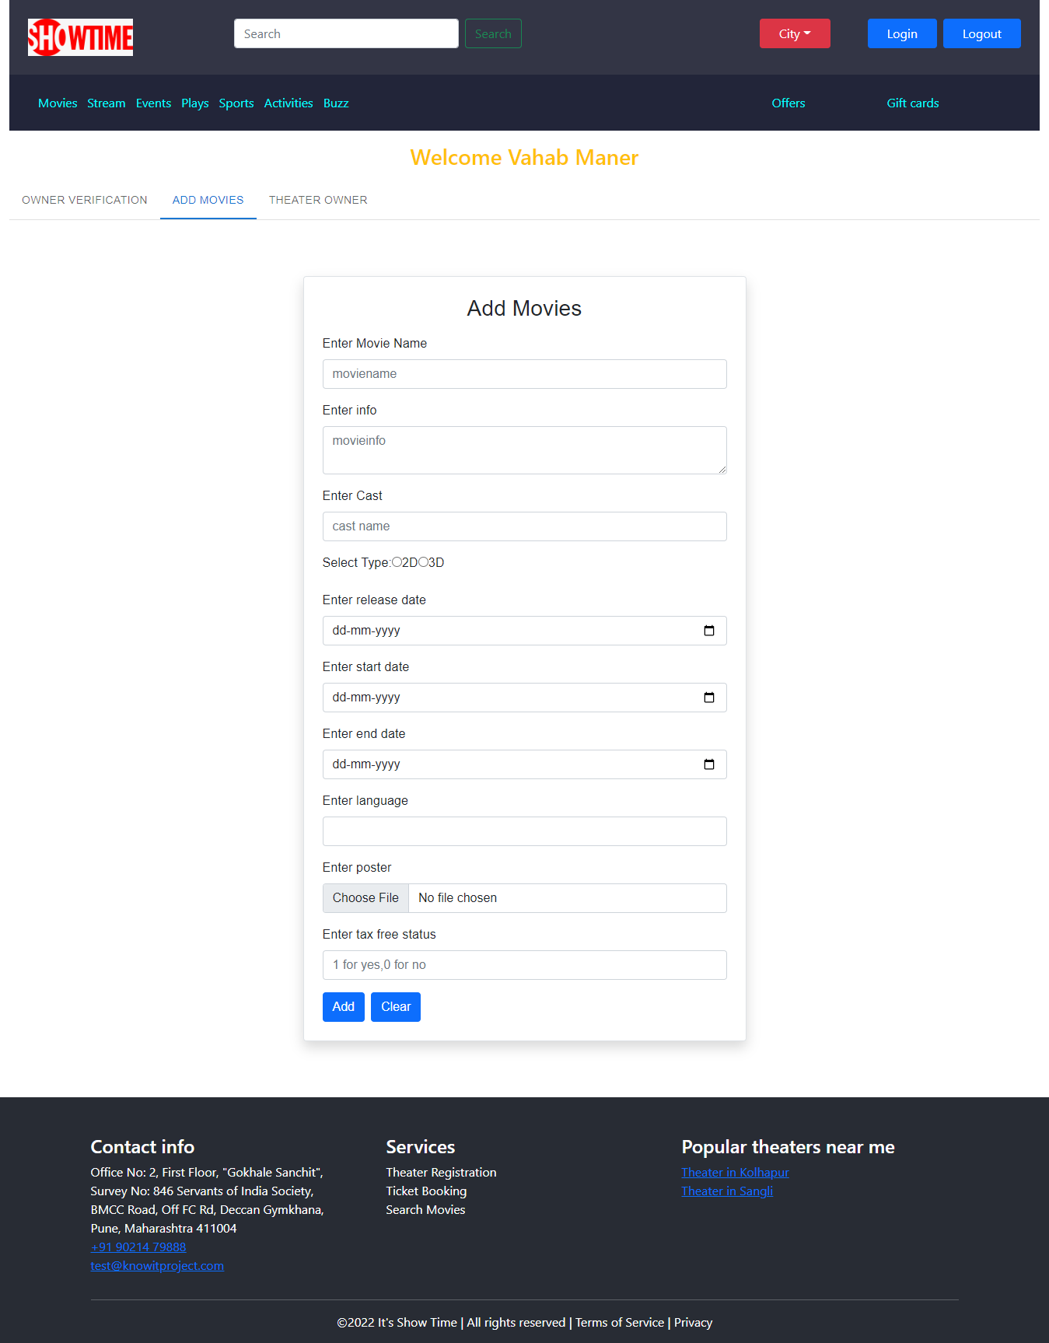
Admin Functionalities

Slide 16
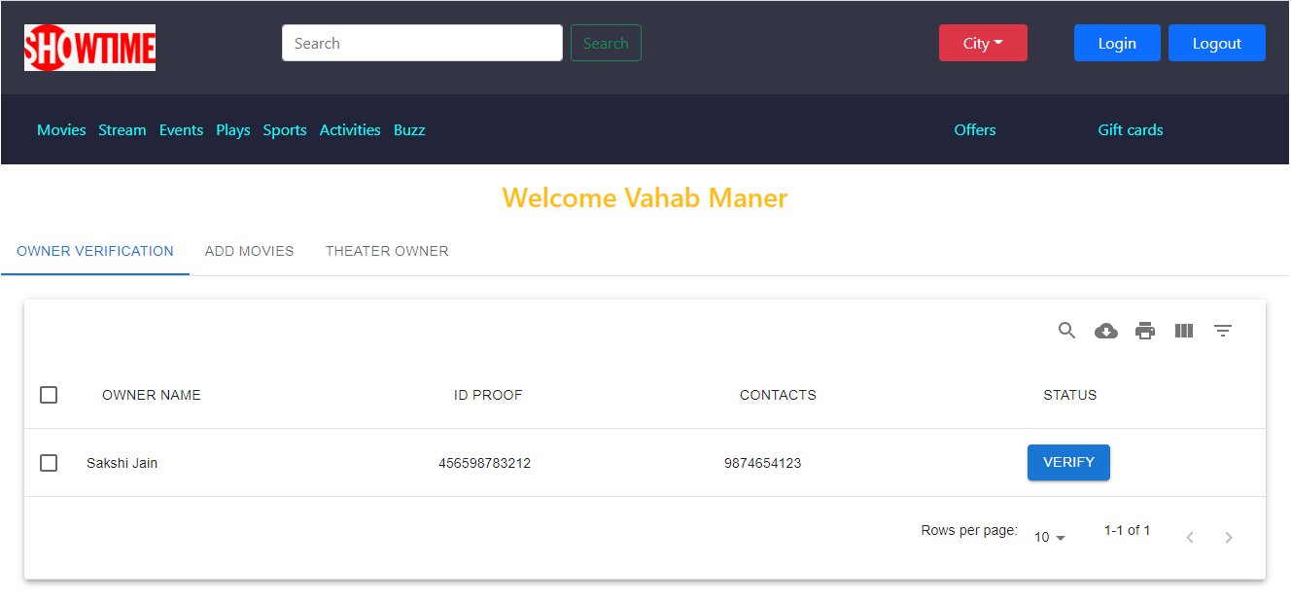
Admin Functionalities

Slide 17
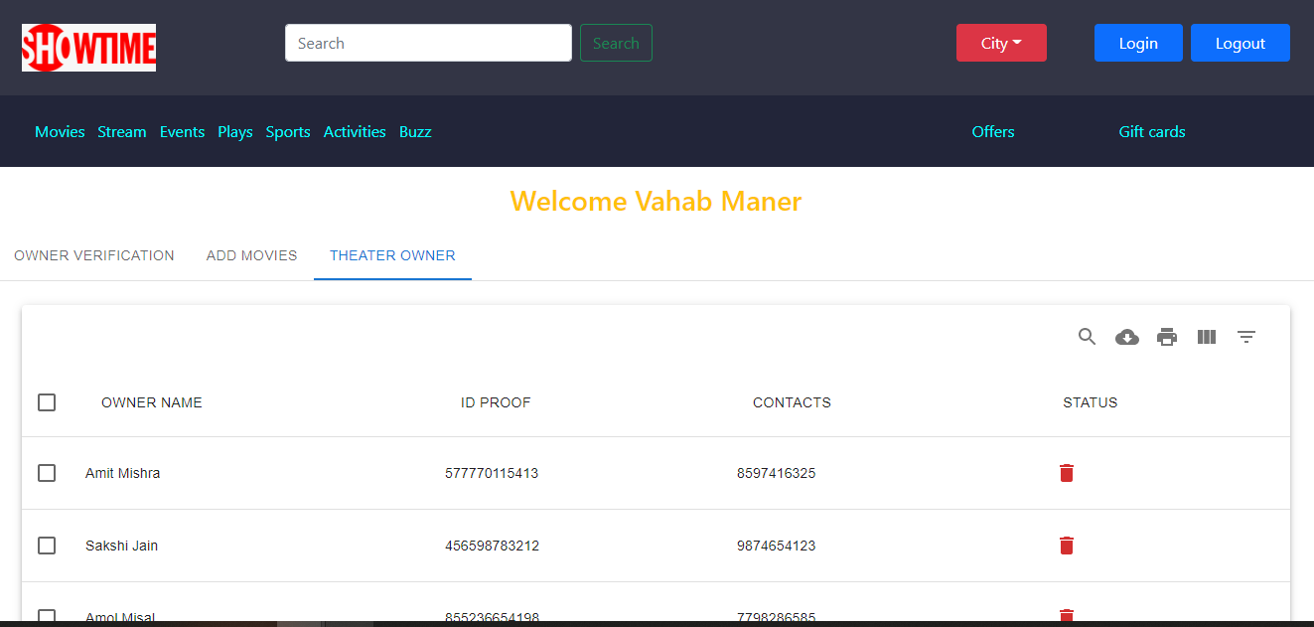
Admin Functionalities

Slide 18
Theater Owner functionality pages:-
Theater Owner Signup
Theater Owner Login
Theater owner Add Theater
Theater owner allot movie to screen
Theater owner remove movie from screen

Slide 19
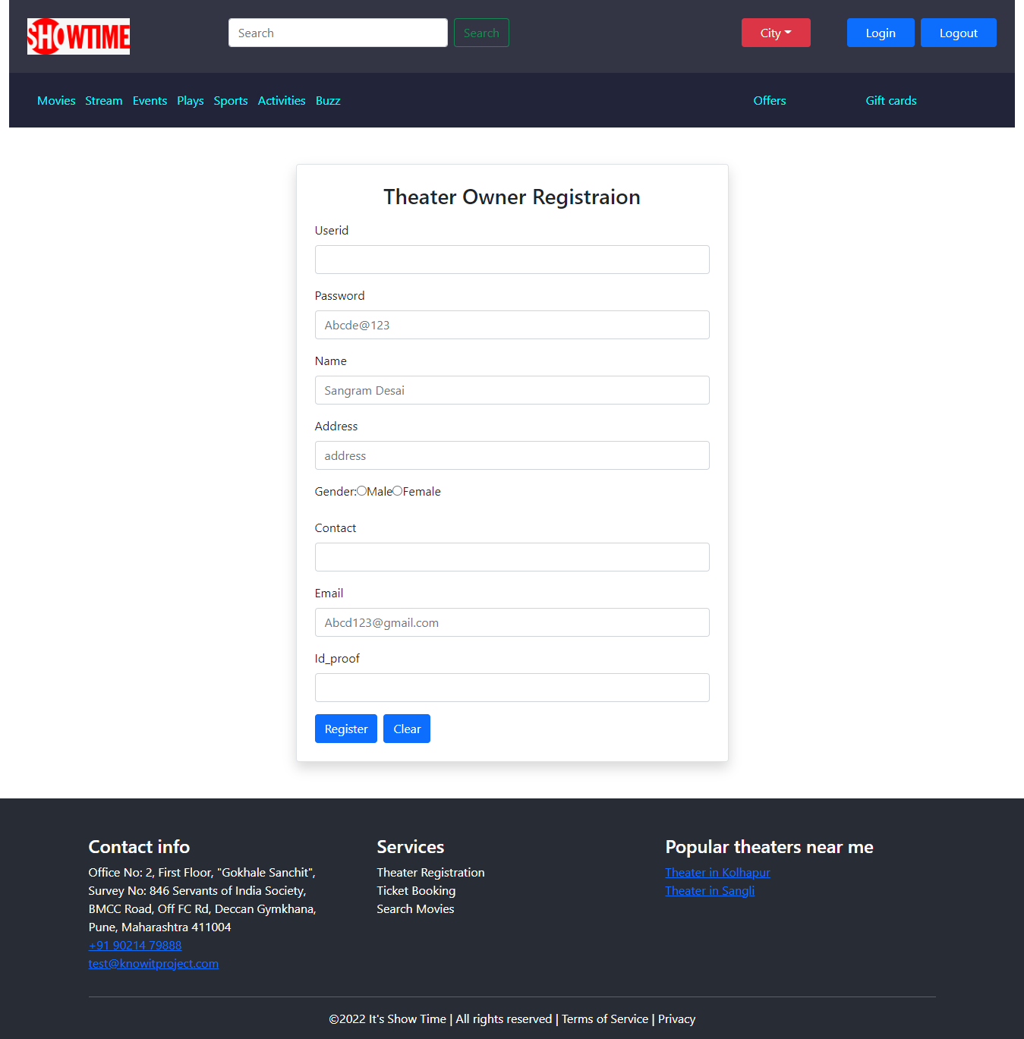
Theater owner Registration

Slide 20
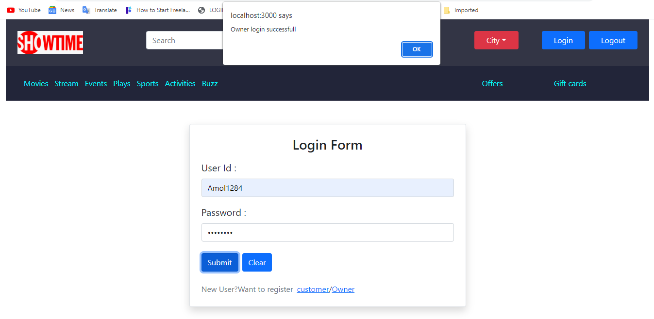
Theater Owner Login

Slide 21
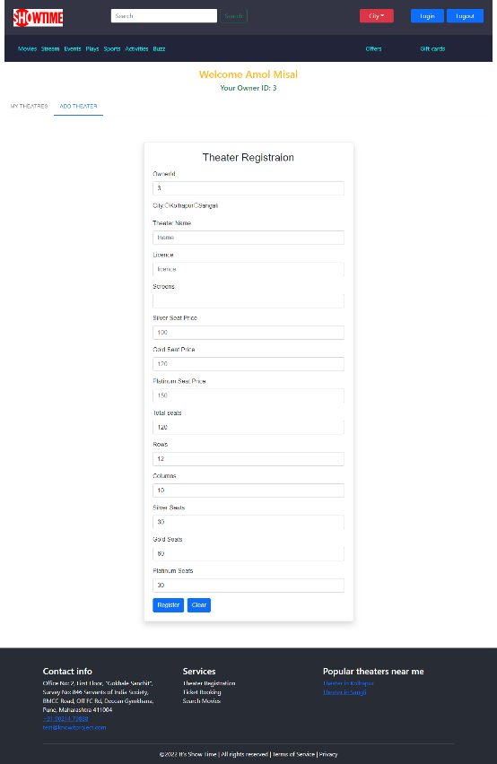
Theater Registration

Slide 22
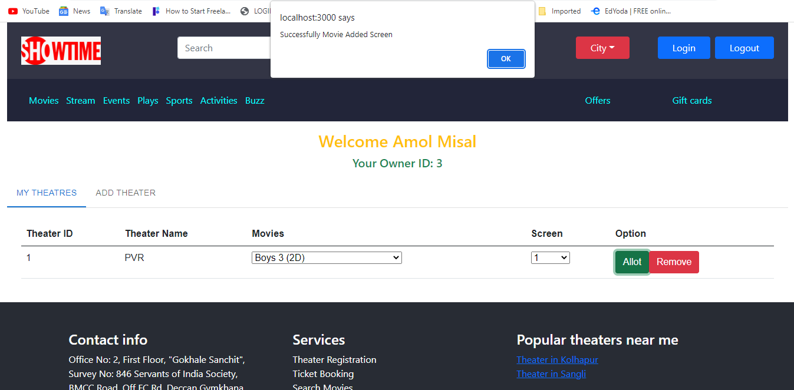
Theater owner allot Screen to movie

Slide 23
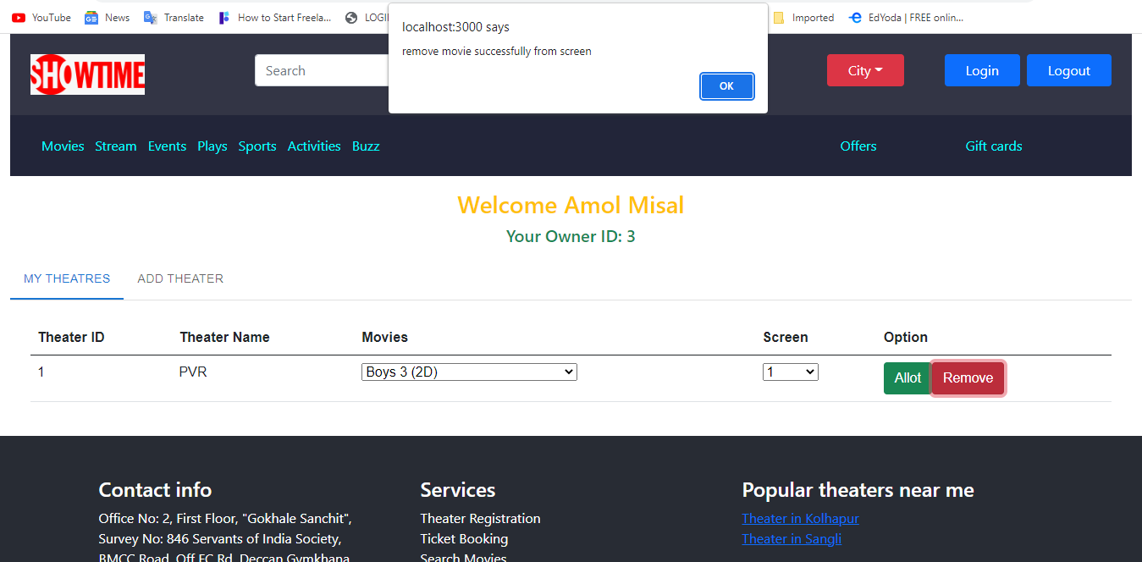
Theater owner remove Screen to movie

Slide 24
Customer functionality pages:-
Customer registration successful Customer
Login successful
Customer get movies
Customers will get theaters by city and movie
Customers get movie time slots
Customers can get available seats
Customers get confirmation page
Customers get confirmation about tickets
Customers can give feedback about platform.

Slide 25

Customer registration successful

Slide 26
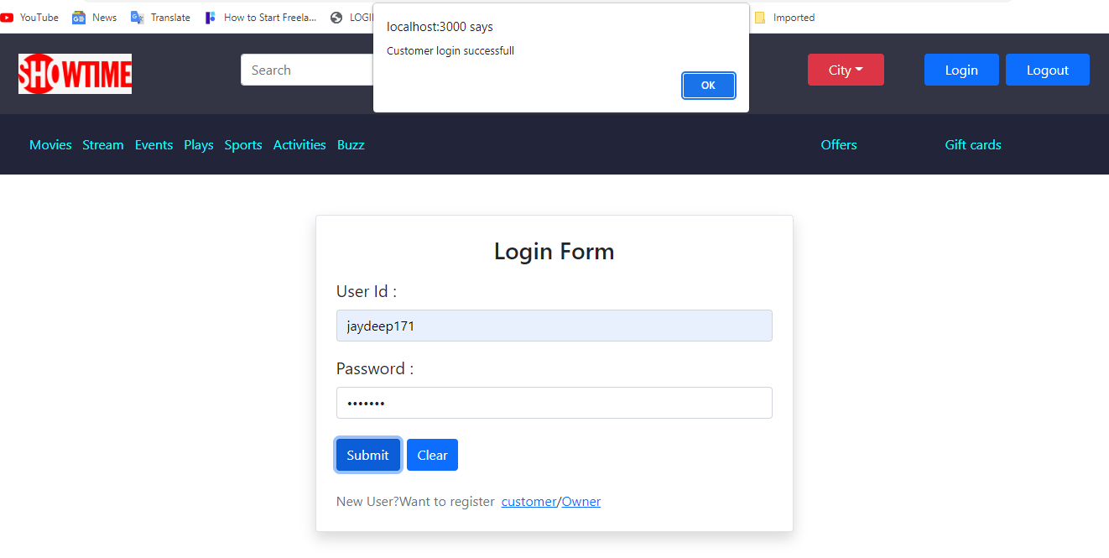
Customer Login successful

Slide 27
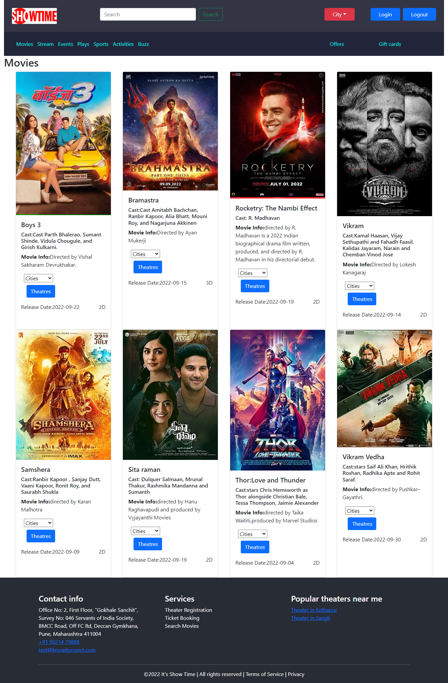
Customer get movies

Slide 28
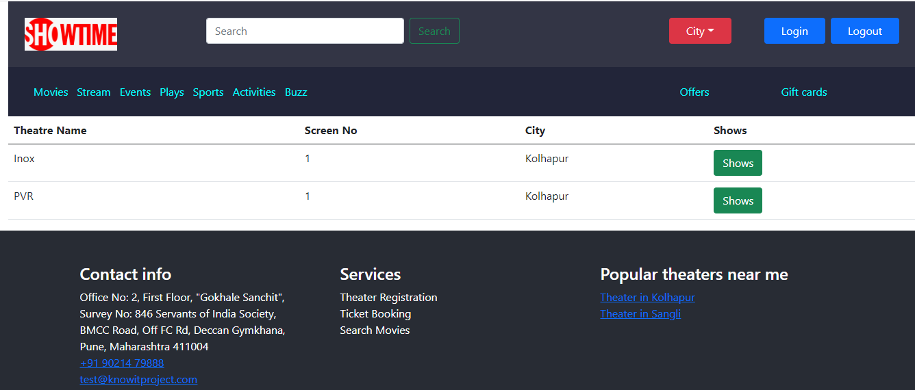
Customers will get theaters by city and movie

Slide 29
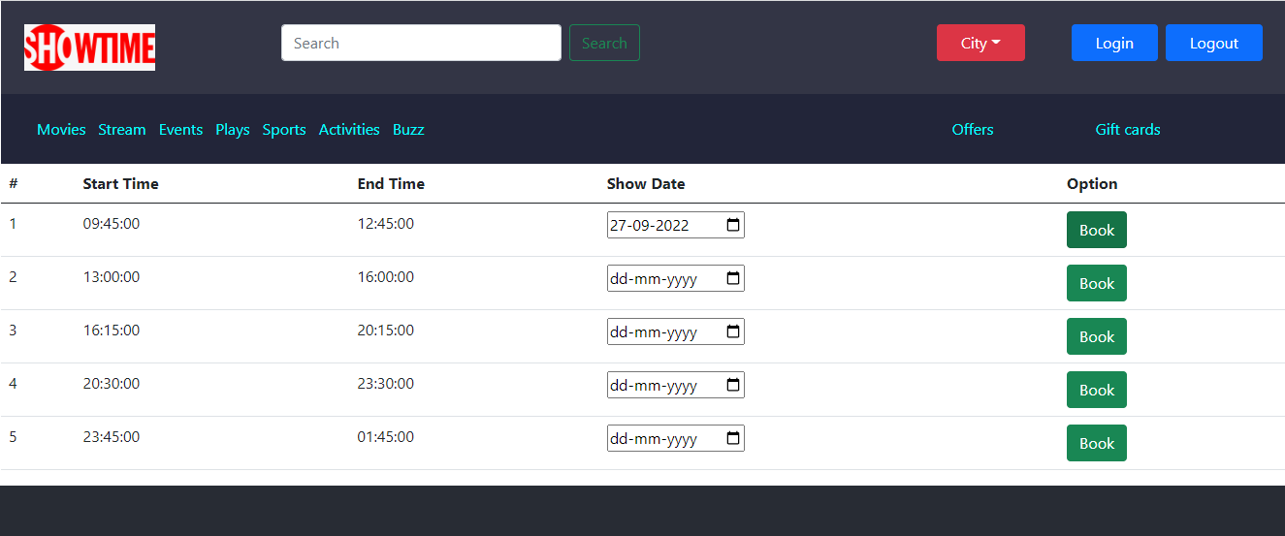
Customers get movie time slots

Slide 30
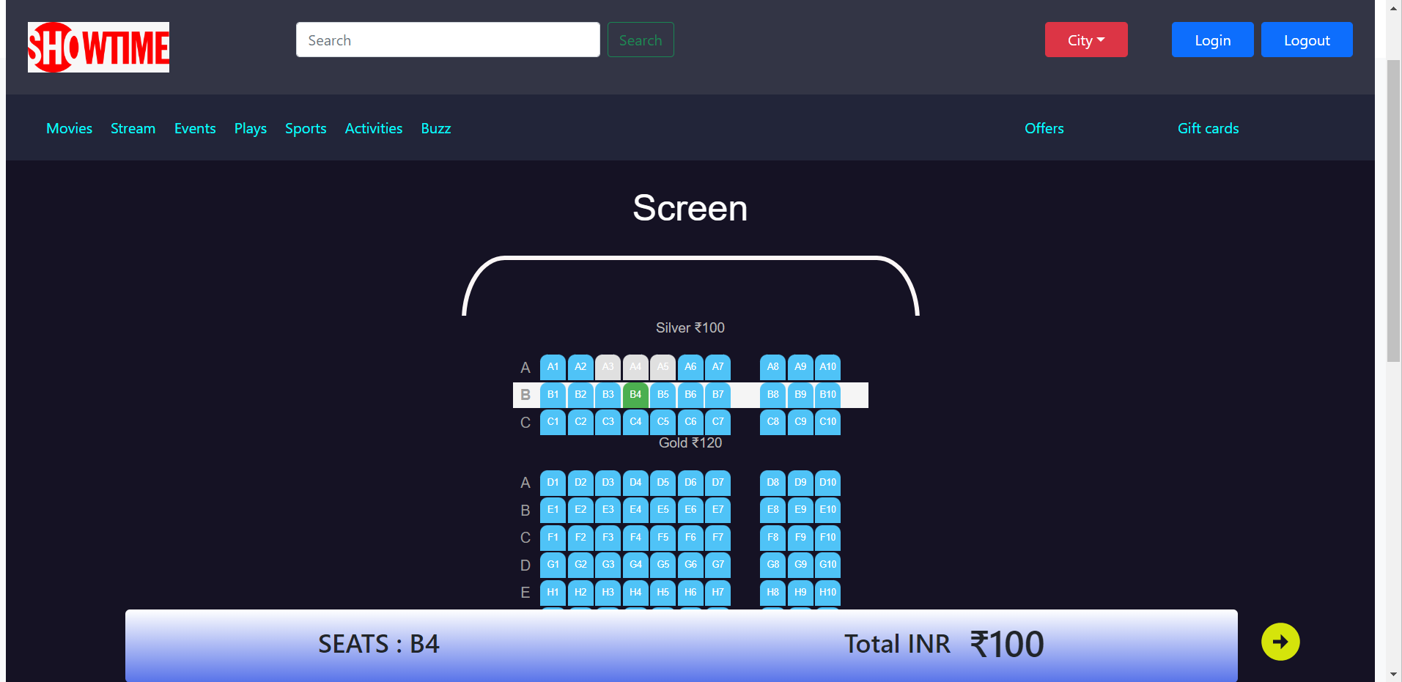
Customers can get available seats

Slide 31
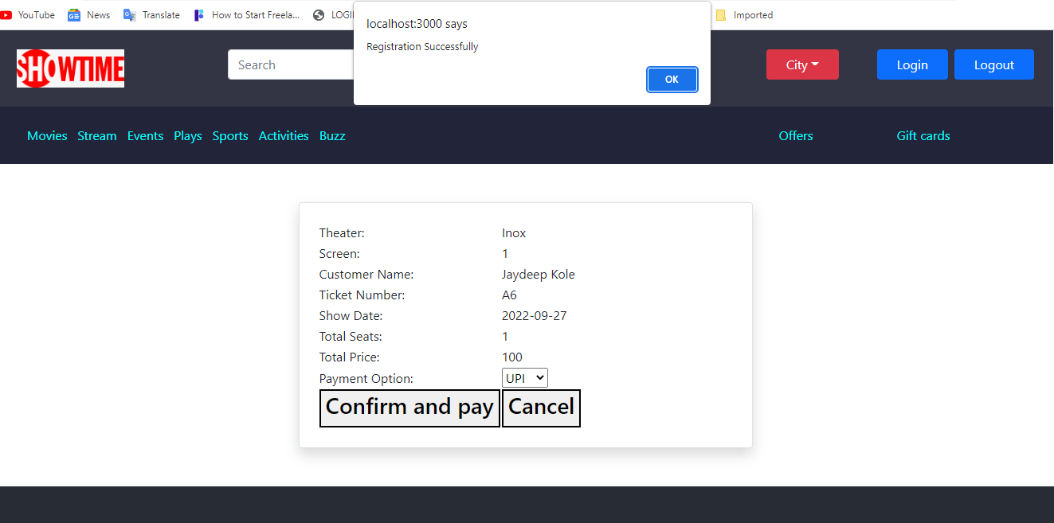
Customers get confirmation page

Slide 32
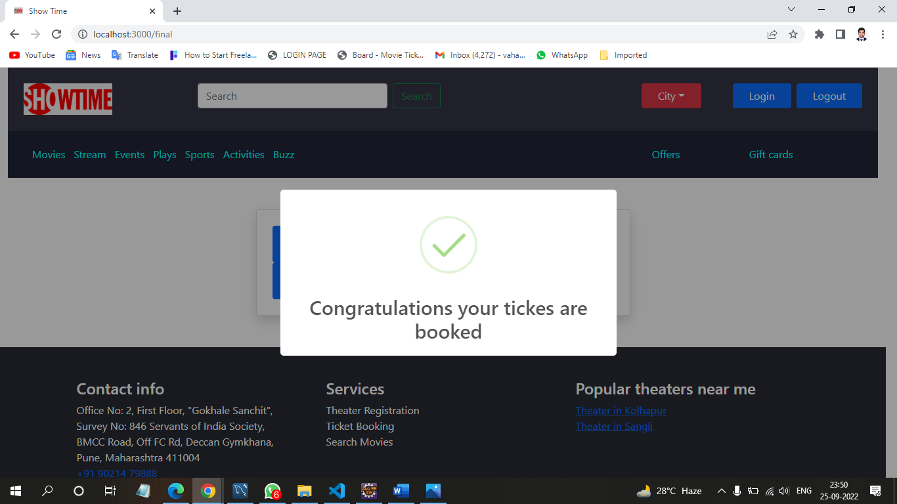
Customers get confirmation about tickets

Slide 33
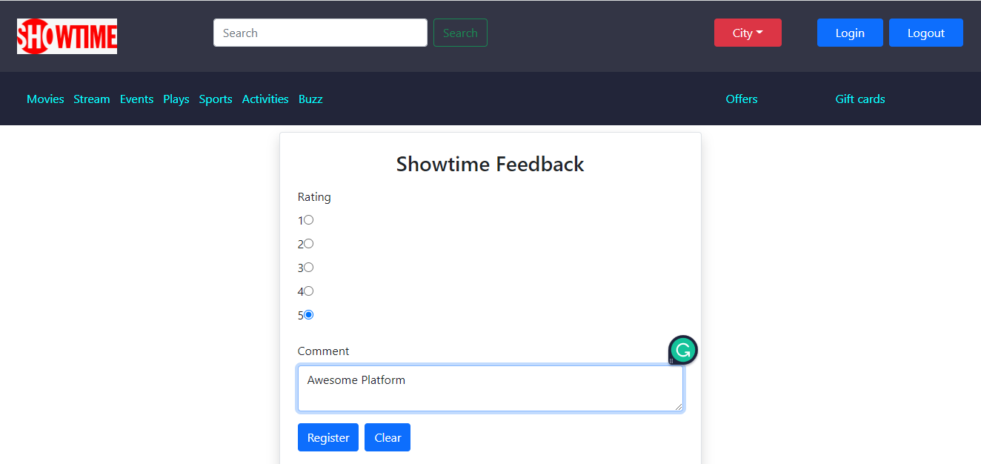
Customers can give feedback about platform.

Slide 34
CONCLUSION AND FUTURE SCOPE
Online Movie Ticket Booking System provides a better platform to get online movie tickets efficiently.
Our System provides a very user-friendly platform where Customers can easily book tickets, check the available seats, and gives feedback to our system, also Theater owner will add theaters and screens, Admin will add the movies, and also verify the theater owners.
Our system is aimed at efficient management of various tasks like booking tickets of customers, Managing allocation of movies, and verification of theater owners.

Slide 35
Thank You….

